Slide 1
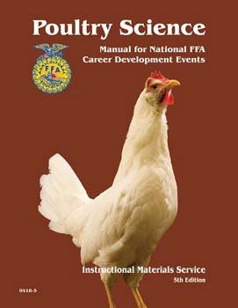
Poultry CDE
Tennessee FFA

Slide 2
Components of the CDE
Production Hens
Broiler Breeders
Interior Quality
Further Processed Meats
  Factors
Exterior Quality
  Factors
Parts ID
Carcass Class
RTC’s
Test
Team Activity

Slide 3
Production Hen Class
Primary focus is pigment loss and handling qualities
LOOK AT PIGMENT 95% of time
Abdomen should be soft, pliable
Pelvic bones should be 3 fingers wide by 4 fingers deep!
Hens can be removed from cage to be evaluated

Slide 4
Pigment Loss
Vent
Eye ring
Ear ring
Beak 1/3
Beak 2/3
Beak entire
Bottom of feet
Shanks
Hocks
Toes

Slide 5
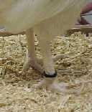
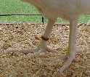
Production Hens
http://www.animal.ufl.edu/Youth/poultry/practiceindex.htm

Slide 6
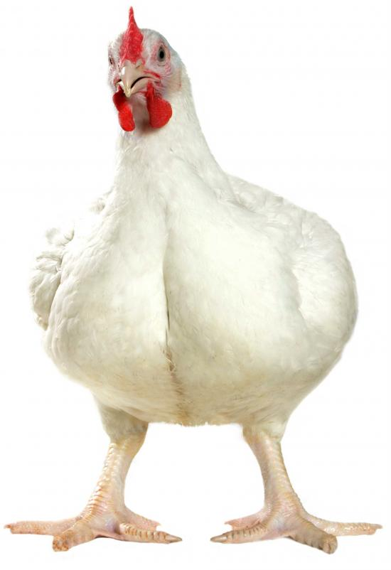
Broiler Breeders

Slide 7
Broiler Breeders – Cull/Keep
Keep 4…..Cull 4!!!
Automatic Disqualifications
  Black feathers on wing, tail or saddle feathers—MALES ONLY.
  Crooked beak
  Crooked toes!! 90 degree turn or more!! Careful
  Green or black shanks
  Blind in one or both eyes
  Crooked Keel Bone
  Swollen Hocks
  Crippled

Slide 8
Broiler Breeders (continued)
SIZE DOES MATTER!!!!! The bigger the bird, the better!!!
Want LONG and WIDE Breast
Birds are handled in cages!!!
Top four birds will have a score of 50 when combined.

Slide 9
Parts ID
It takes about 7 carcasses to get each cut
Make cuts and then freeze and thaw
If cuts get ripe, dip them in a bleach and water solution and then refreeze!
Pictures are OK but real parts are better
Knowing bone structure helps with ID!

Slide 10
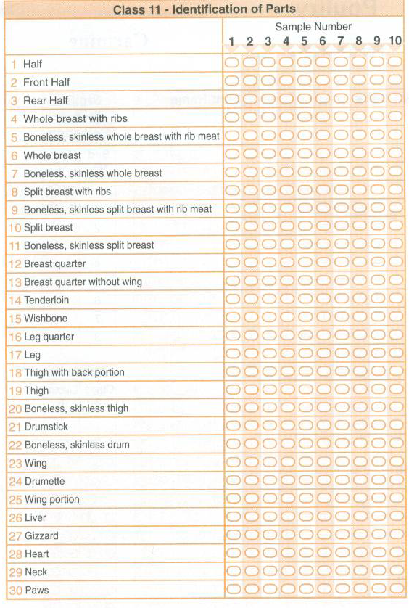
Parts

Slide 11
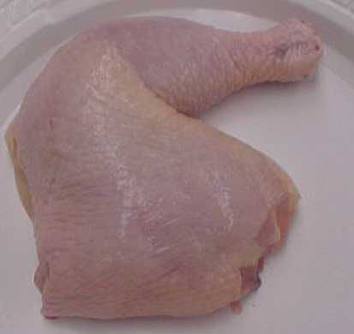
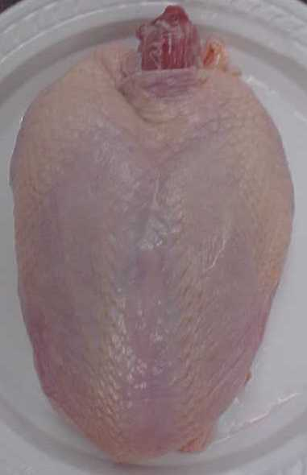
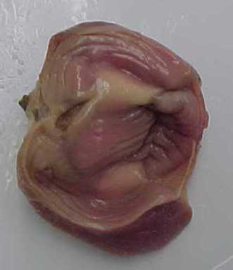
Parts

Slide 12
Parts ID
Hyperlink to some parts on internet
http://www.animal.ufl.edu/Youth/poultry/showme/4hpartsid.htm

Slide 13
Interior Egg Quality
Quality of interior is based on air cell size
AA, A, B, Loss!
  AA – Dime
  A – Nickel
  B - Quarter
Yolk size and shape can also help detect quality
Losses will be blood spots and/or meat spots. Cracked eggs are too hard to monitor!

Slide 14

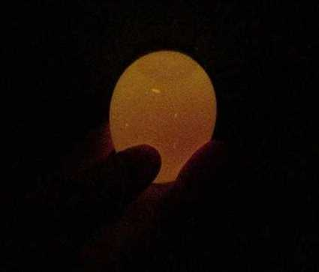
Interior Quality

Slide 15
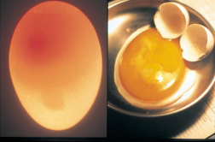

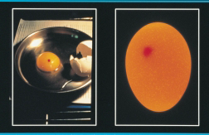
Loss Eggs

Slide 16
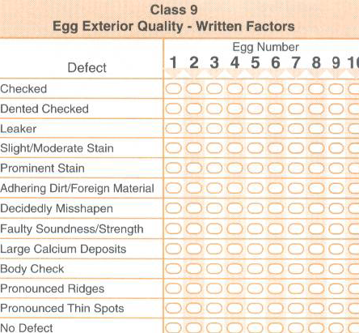
Exterior Quality Factors
NG
NG
NG
B
NG
NG
B
B
B
B
B

Slide 17
Exterior Quality GRADING
Exterior quality is based on shell quality
Stains
  1/32 of shell or less – B
  Over 1/32 of shell – NG
    Stains cannot be washed off!!! Coffee is great to make stains if you have to!
Adhering Material
  Any foreign material that is attached to the shell
    Manure, Blood, Fly Spots, Dirt, Shells, Albumen, Yolk

Slide 18
Exterior Grading
Leaker
  Any check where the inner shell has been torn and the albumen is leaking on the outer shell
  If counted as leaker DO NOT call checked or Dented Check!
Check (Cracks)
  Any crack is considered a NG!
  Hairline cracks are often identified by “moisture webbing”
  Inner membrane NOT broken
Dented Checks (cracks)
  Literally a dent in the shell
  Inner membrane NOT broken

Slide 19
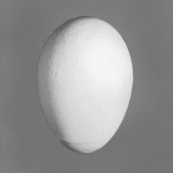
Normal Shell Egg

Slide 20
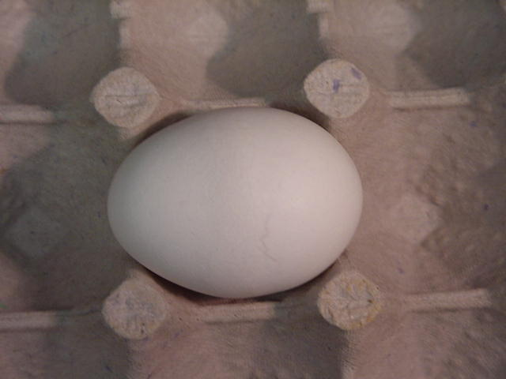
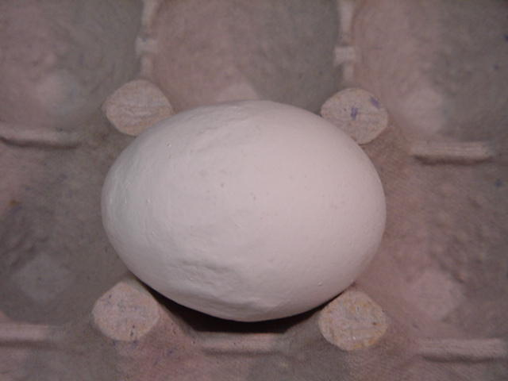
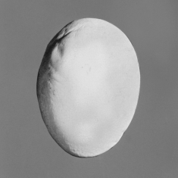
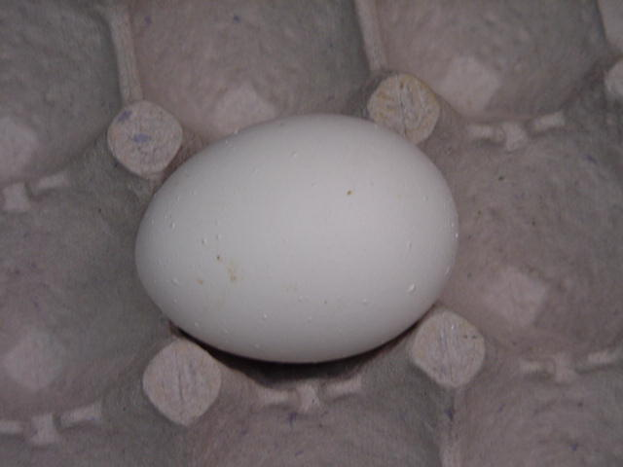
Abnormal Shape

Slide 21
Causes of Faulty Soundness

Slide 22
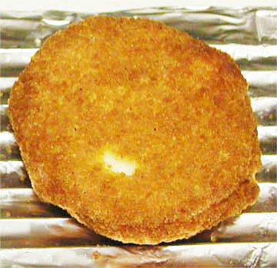
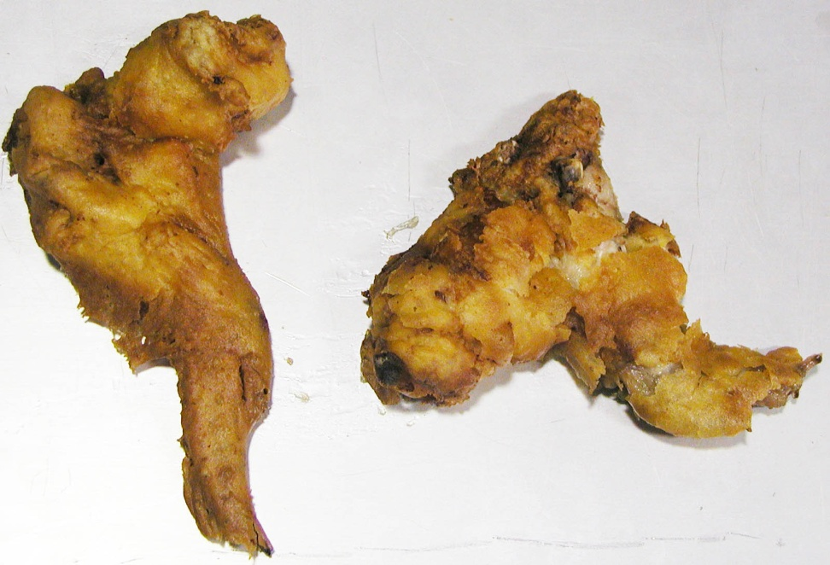
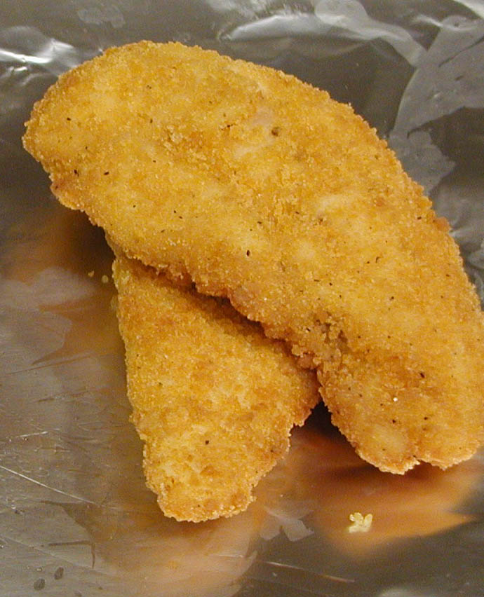
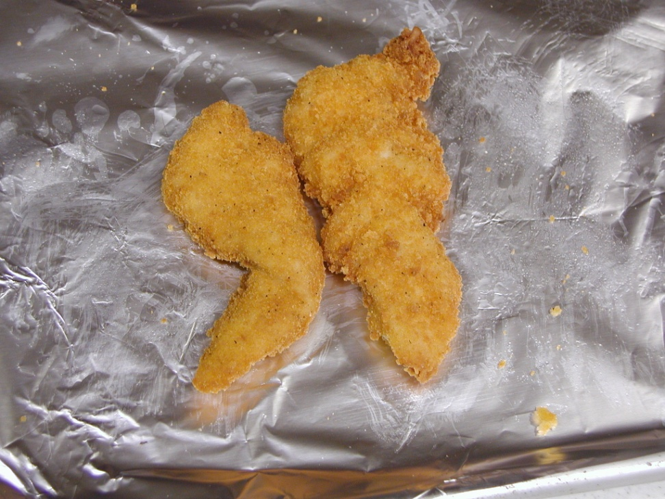
Further Processed Meats

Slide 23
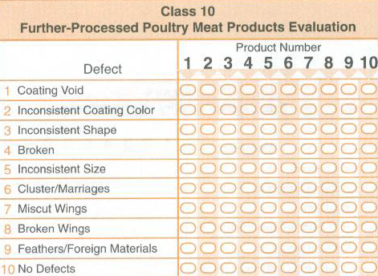

Slide 24
Further Processed Products
Broken
  Any product that is broken
Coating Voids
  Patties
  Tenders
  Wings
  Nuggets
Foreign Material – NG
  Shells, hair, bone fragment, staples/metal, etc

Slide 25
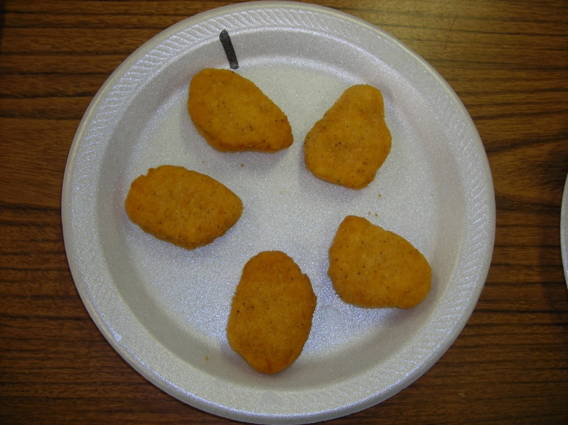
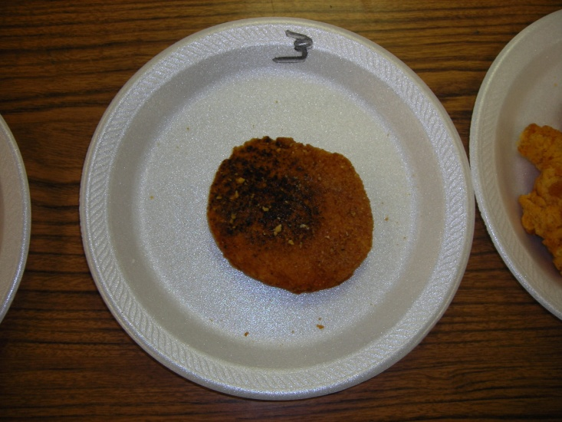
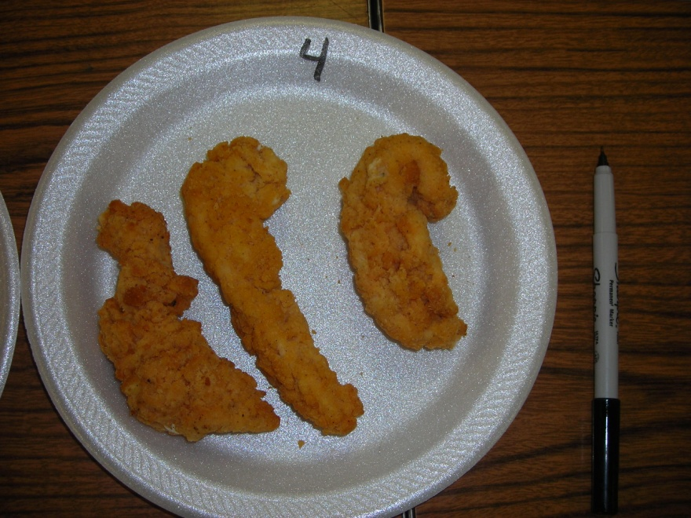

Slide 26
Ready to Cook Grading
Exposed Flesh
    A (Parts)
    A (Whole birds)
      up to ¼” on meaty parts (breast and legs)
      Up to 1.5” on non-meaty parts
    B (Whole birds and parts)
      Up to 1/3 of each individual part of the bird
    C (Whole birds and parts)
      Unlimited. You can literally remove ALL skin!!!
      Exposed flesh WILL NOT MAKE A “NG”

Slide 27
Ready to Cook Grading
Grades A-B-C
Non Gradable
Missing Parts
  A
    Wing tips and tail
  B
    Wing tips and Flat
    Square cut that goes ½ way to hips
  C
    Entire Wing
    Square that extends to but NOT beyond the hip bones
  NG
    Square cut of cut that extends past hip bones
    ANY MISSING FLESH on Breast, Back or Legs
    Watch for cut on keel bone tip
    Watch for cuts on V of neck!
    Watch for missing Oyster Muscle

Slide 28
Ready to Cook Grading
Broken and Disjointed Bones
  A
    1 Disjointed and NO BROKEN
  B
    2 Disjointed and 1 broken NON PROTRUDING
  C
    ANY Broken PROTRUDING bone!!!
    Broken and disjointed bones CANNOT make NG

Slide 29
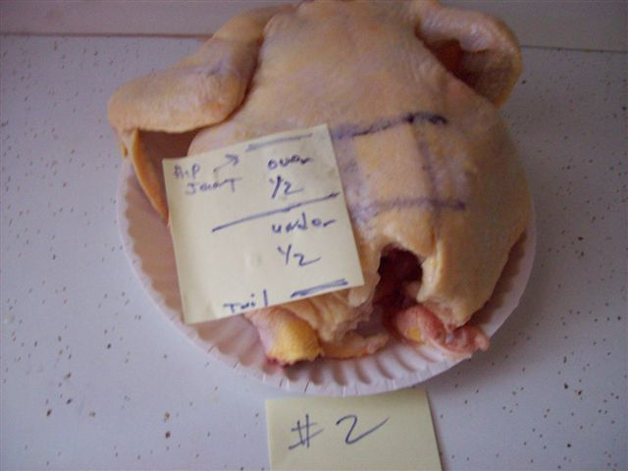

Slide 30
Carcass PlacingClass
Turkeys or Chickens
  Grade birds first and place by grades
  If graded the same, place by size!!!!!
  WIDE and SQUARE breasts are best
  SIZE, SIZE, SIZE, SIZE!!!!!

Slide 31
Test
ALL QUESTIONS will come from Poultry Manual available from National FFA!
30 questions worth 5 points each!
5-6 “Math Problems”
2-3 vocabulary
Odd and Even years use different segments of the book

Slide 32
Team Problem
MATH, MATH, MATH, MATH, MATH!!!
DO NOT forget calculators

